Slide 1
Crime data in San Francisco for businesses and tourists
Augusto González Bonorino

Slide 2
Important aspects of San Francisco crime
Violent crimes are concentrated in limited areas, mostly not near the tourist areas.
Crimes most likely to affect tourists are the car break-ins (somewhat preventable).
San Francisco is not particularly dangerous when compared with other cities, especially U.S ones.
Crime rate in San Francisco varies tremendously by neighborhood, as you would also expect

Slide 3
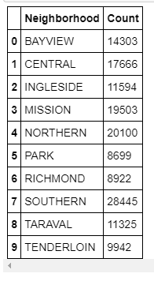
The graph on the left shows the criminal cases, either violent or non-violent, per neighborhood.
The Tenderloin, although one of neighborhood with the fewest crimes, has the unfortunate honor of being the worst in the city for both violent crime and property crime.
The misión district, second neighborhood with the most amount of cases, has been experiencing a “transition”. Crime is reducing and it has become a popular place among artists, writers and hispanics.

Slide 4
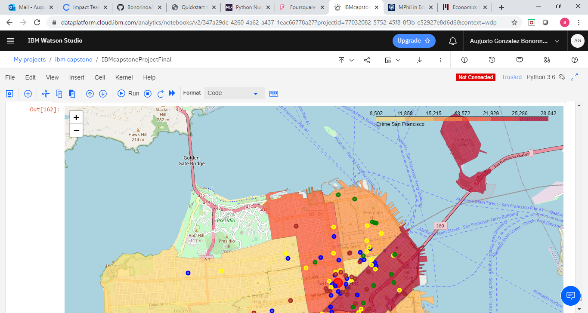
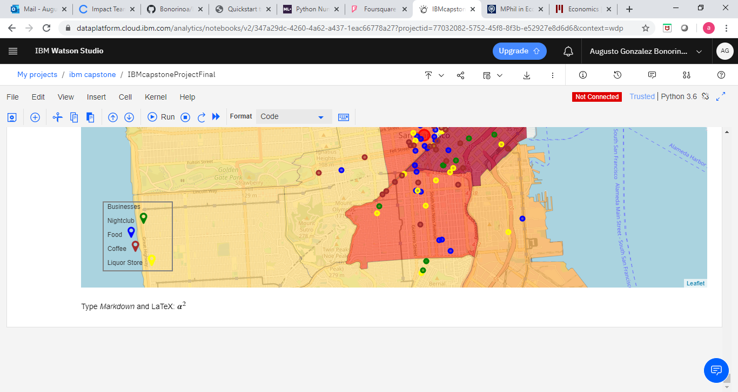
As you might notice, businesses tend to cluster inside or around the most dangerous areas in San Francisco.
This attracts a higher quantity of tourists to this areas, who might not be aware of the risks.
The map on the left shows the neighborhoods with the highest quantity of crimes in a darker red and viceversa.
Coffee shops (brown), restaurants (blue), nightclubs (green) and liquor stores (yellow) were extracted from Foursquare API and plotted in the graph because those tend to be the most frequently visited by tourists.

Slide 5
Data acquisition
The information regarding crime data of the different neighborhoods in San Francisco was obtained from the following address: https://cocl.us/sanfran_crime_dataset.
To plot the boundaries of each neighborhood on the choropleth map we have used information gathered from the following geojson file: https://cocl.us/sanfran_geojson.
Finally, to be able to plot the location of the businesses in San Francisco I used the Foursquare places API. I have downloaded information about the name, category and location of all the coffee shops, restaurants, nightclubs and liquor stores around a 10km radius from downtown San Francisco.
For better understanding on what Foursquare is I attach the link to the product page Foursquare_places and to its main page Foursquare.com.

Slide 6
Data cleaning
The process of cleaning the data consisted on three simple steps:
First, I imported the csv file containing the San Francisco crime data to the IBM Watson Studio platform to be able to manipulate it using python 3.6.
Second, after a short visual analysis of the dataset I dropped the columns that were unnecessary for the project. The following columns from the original data set were dropped: IncidntNum, Category, Descript, DayOfWeek, Date, Time, Resolution, Address, X, Y, Location, PdId
*It is worth noting that some of the data found under such columns, like Time and DayOfWeek, might be of future interest to further improve the accuracy of the current project.
Third, a new column called ‘Count’ was generated by grouping the crimes by neighborhoods. This way I was left with the total amount of cases per neighborhood. Such data was used as the scale to plot the choropleth map and assign the proper color tonality to each neighborhood according to the total quantity of cases.

Slide 7
Conclusions
Most of the businesses analyzed (cafes, restaurants, nightclubs and liquor stores) are located inside or near those neighborhoods that present high numbers of crime cases, exposing tourists to high risks in the city of San Francisco.
Regarding the benefits for entrepreneur and prospective business owners, we have provided information, in addition to the potential risks each area conveys, of locations where certain businesses might be allowed to thrive.
In conclusion, most of the businesses in San Francisco are clustered near high risk neighborhoods which increases the risks for tourists and because of that those areas attract a high number of tourists.

Slide 8
Tips before visiting such areas
During the daytime, it's much less risky, but don't pull out wads of cash or walk glued to a smart screen.
If you attend a performance in the evening, there will be lots of other people around, arriving and leaving, so there's safety in numbers.
If you don't want to walk several blocks at night from a bus stop or BART, taxis, Uber or Lyft are an option.
Always be aware of your surroundings, do not be distracted on your phone while walking in the streets. If you need to look up something, enter a store look it up and continue your journey.

Slide 9
Future thoughts
We believe much more can be added to what it is been currently presented, more detailed data from crimes and businesses as well as geo spatial data to incorporate other cities in the US and maybe even countries in the future.
Some of the potential applications of the data presented in this project include:
The implementation of new policies issued by the department of tourism to protect tourists
Development of new apps like yelp, google maps and foursquare city guide, or the improvement of those mentioned, where this information is provided to the user;
This information could also be included by businesses such like Airbnb or travel agencies and many other possibilities.

